Slide 1
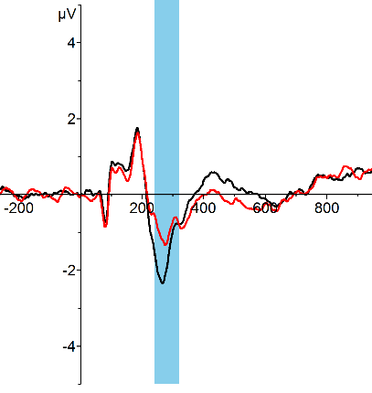
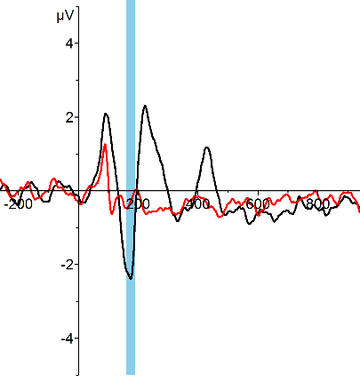
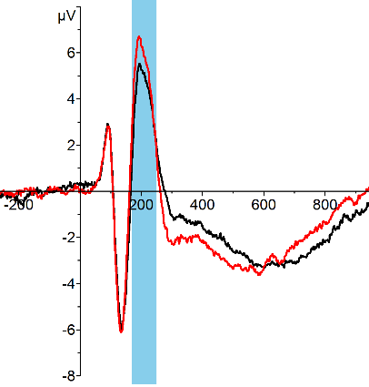
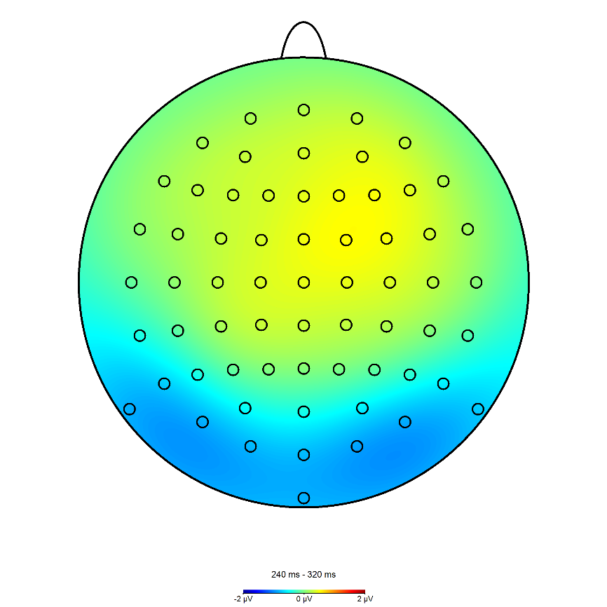
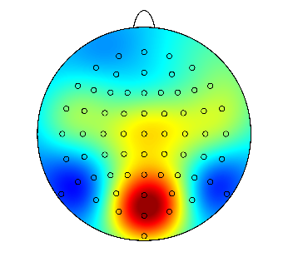
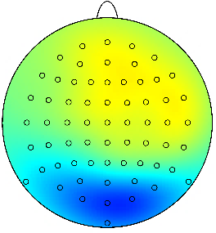
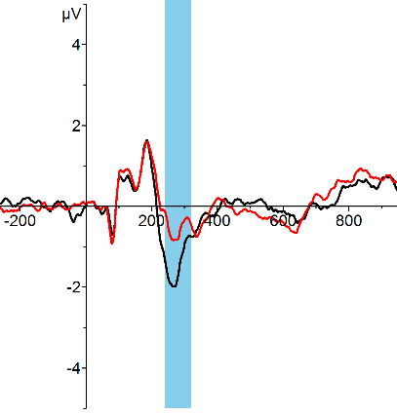
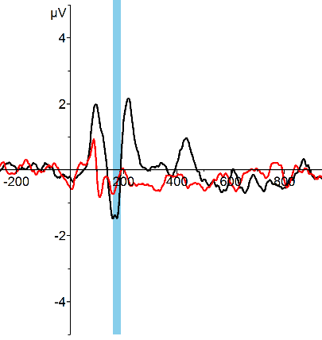
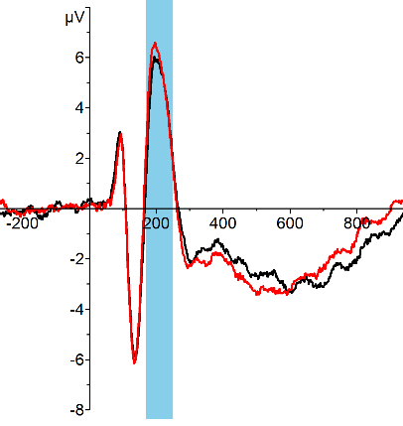
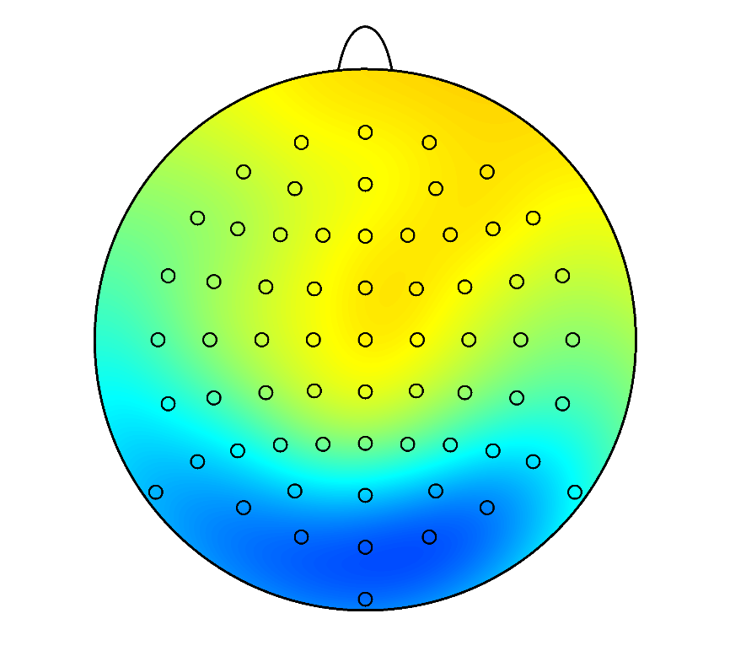
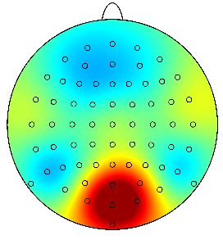
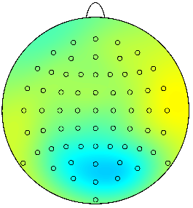
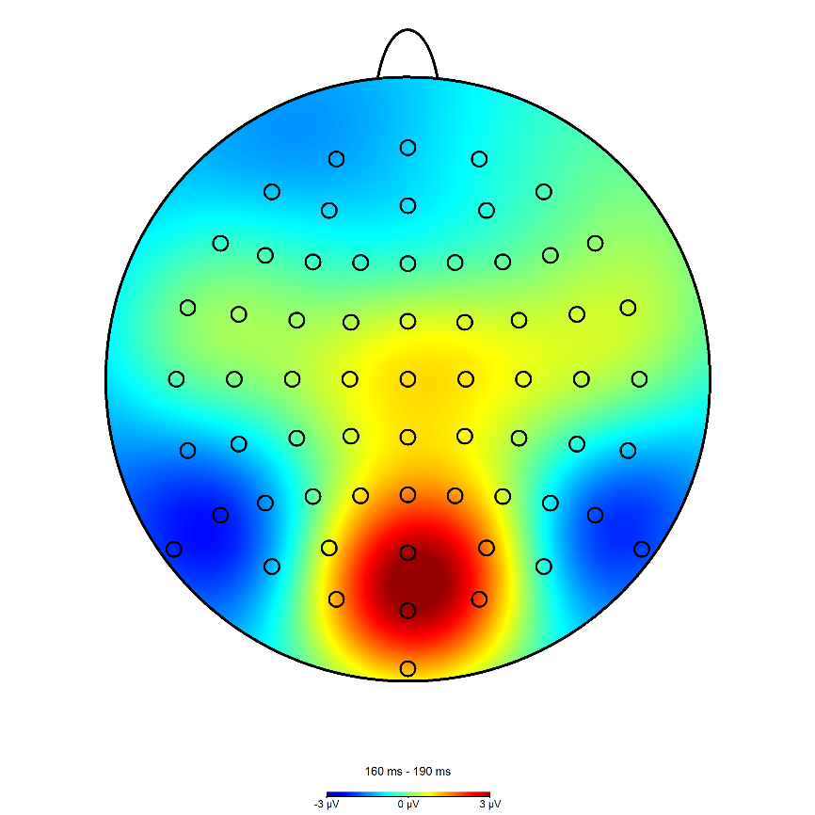
VAN
Dichoptic Color Fusion
Masking
Inattentional Blindness
Visible
Invisible
Pooled channels
*
Faces
*
*
*
*
*
*
*
*
*
*
*
*
*
*
*
*
*
*
*
*
*
*
*
*
*
*
*
*
*
*
*
*
*
*
Houses
*
*
*
*
*
*
*
*
*
*
*
*
*
*
*
*
*
*
*
*
*
*
*
*
*
*
*
*
*
*
*
*
*
*

Slide 2
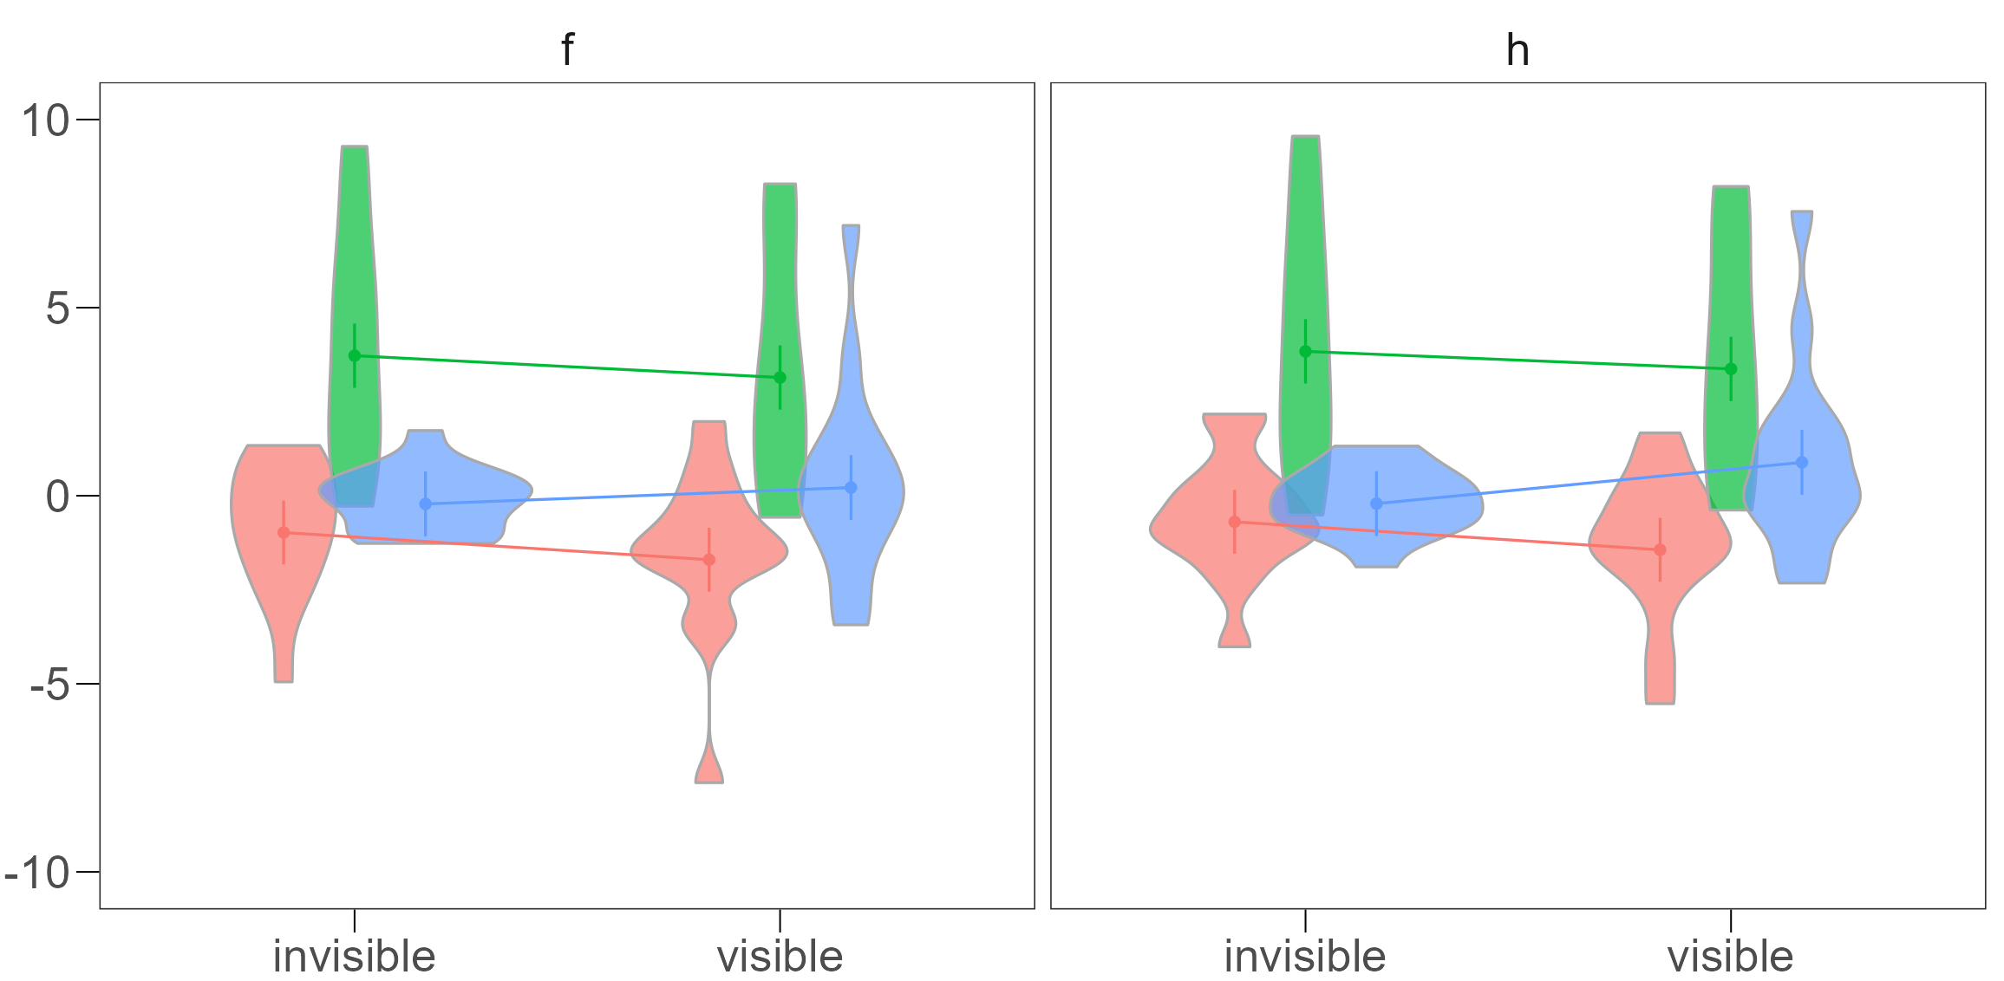
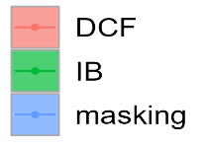
Faces
Houses
Voltage [µv]
DCF
IB
Masking
Invisible
Visible
Invisible
Visible

Slide 3
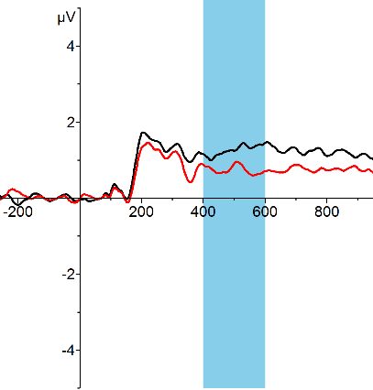
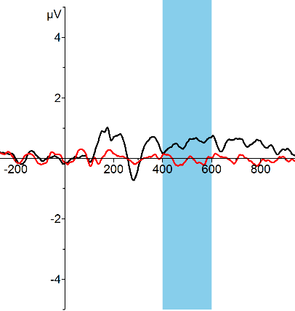
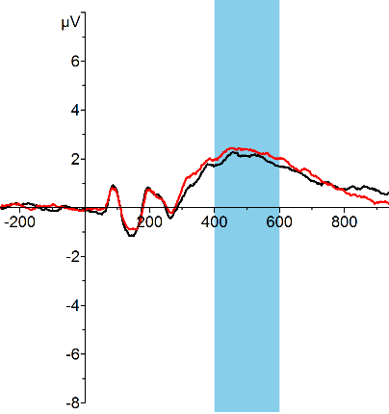
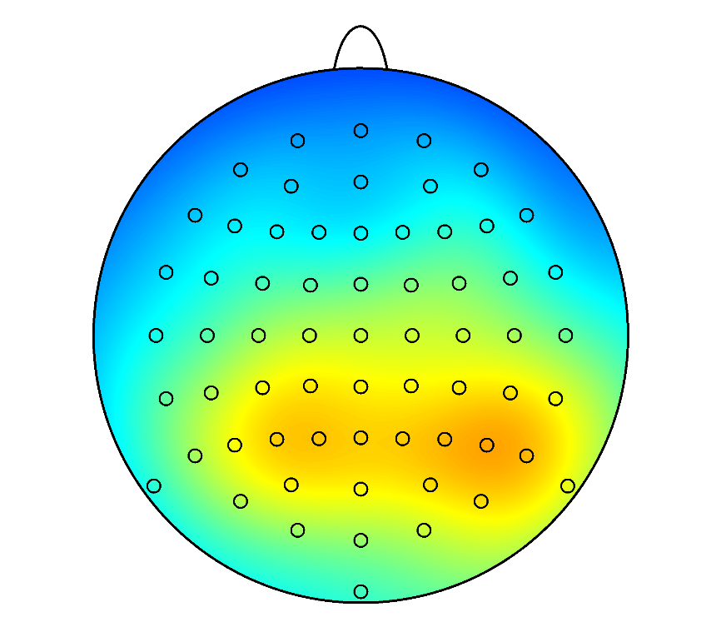
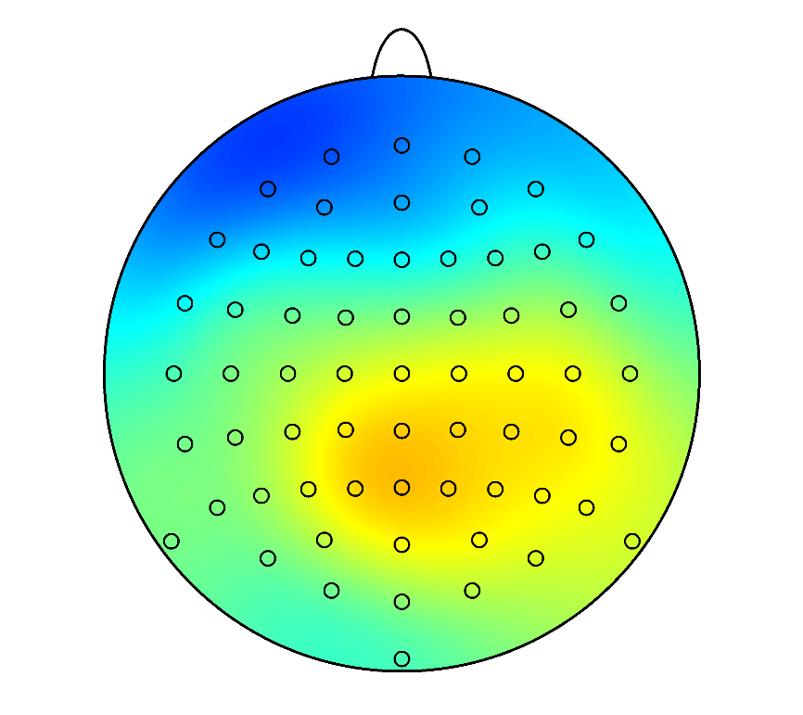
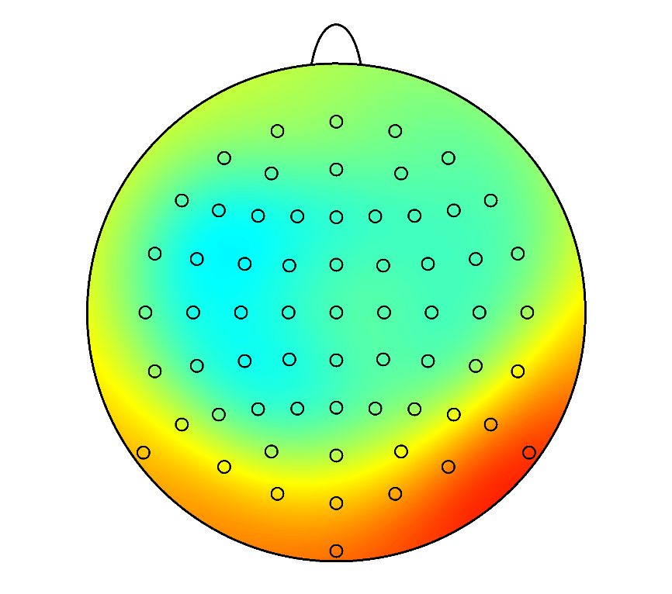
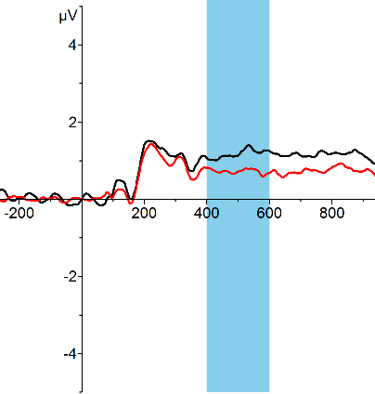
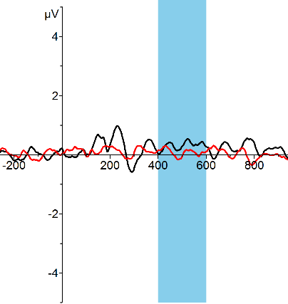

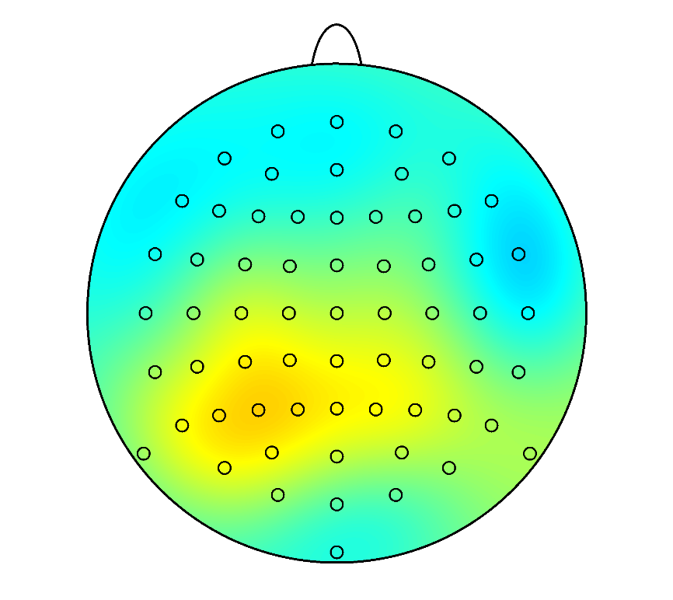
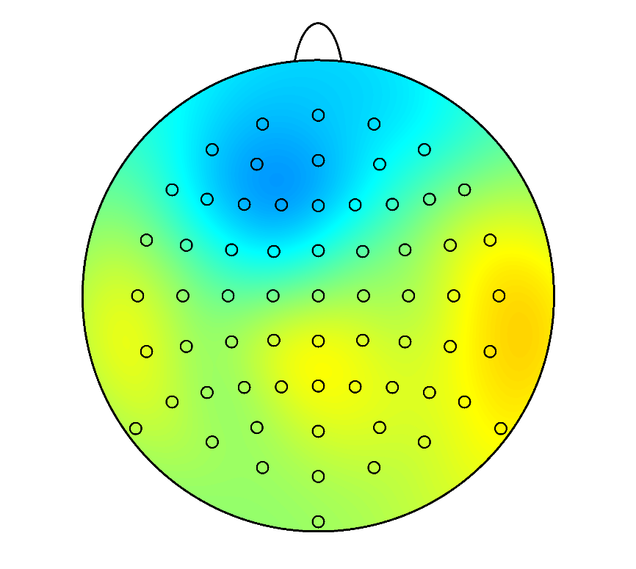
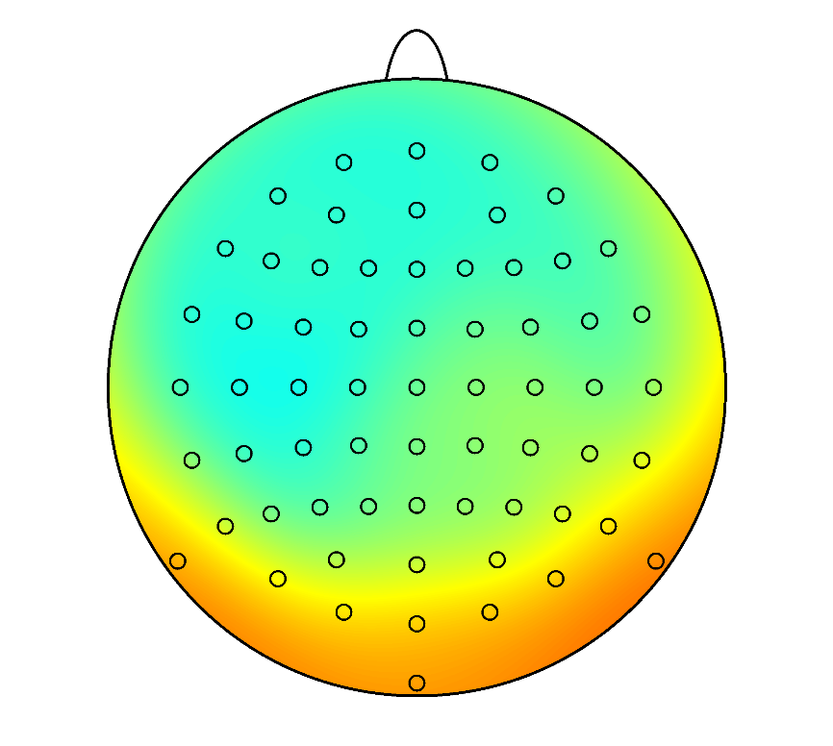
P3b
Dichoptic Color Fusion
Masking
Inattentional Blindness
Visible
Invisible
Pooled channels
*
Faces
*
*
*
*
*
*
*
*
*
*
*
*
*
*
*
*
*
*
*
*
*
*
*
*
*
*
*
*
*
*
*
*
*
*
*
*
*
*
*
*
*
*
*
*
*
Houses
*
*
*
*
*
*
*
*
*
*
*
*
*
*
*
*
*
*
*
*
*
*
*
*
*
*
*
*
*
*
*
*
*
*
*
*
*
*
*
*
*
*
*
*
*

Slide 4

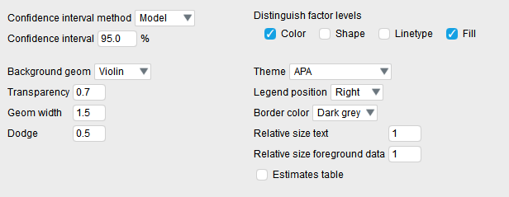
Faces
Houses
DCF
IB
Masking
Voltage [µv]
Invisible
Visible
Invisible
Visible

Slide 5
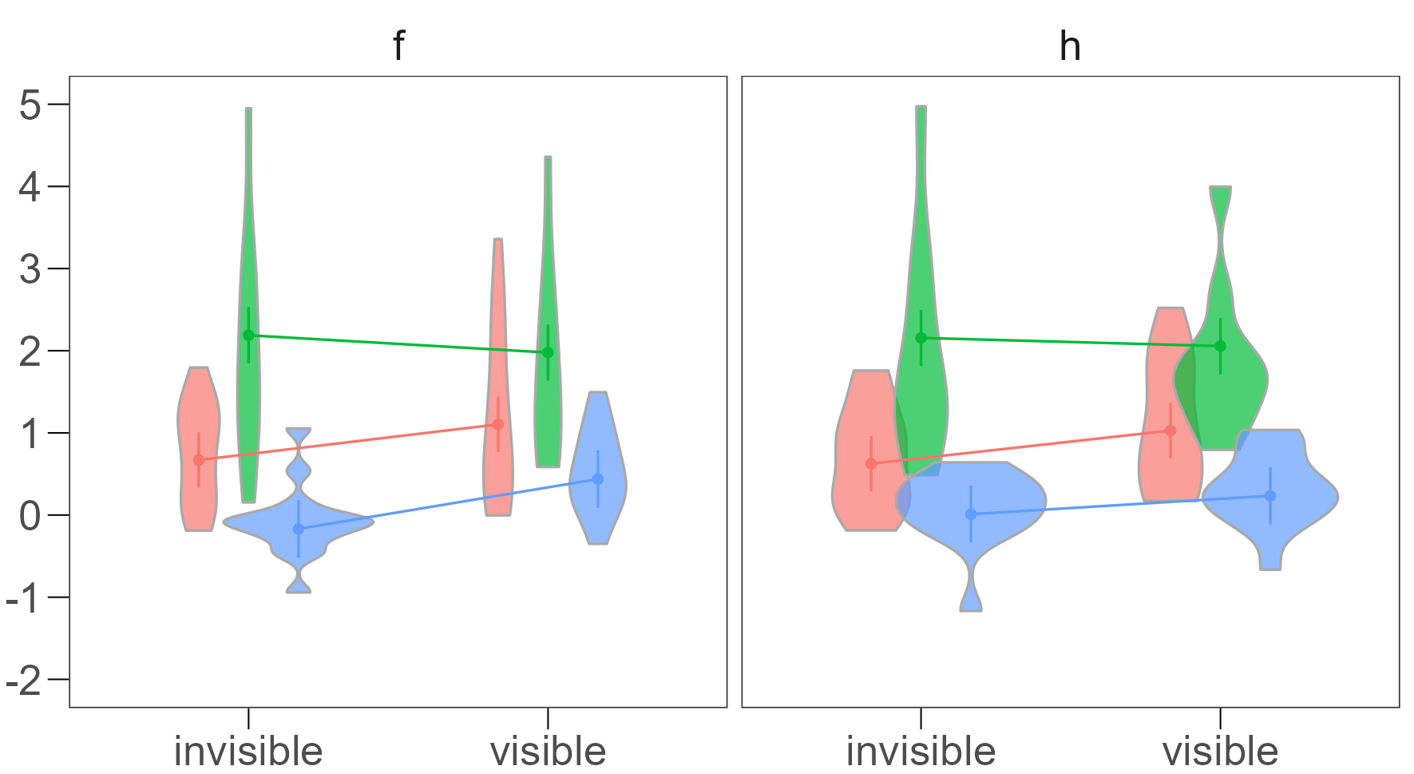
Faces
Houses
Voltage [µv]
DCF
IB
Masking
Invisible
Visible
Invisible
Visible

Slide 6
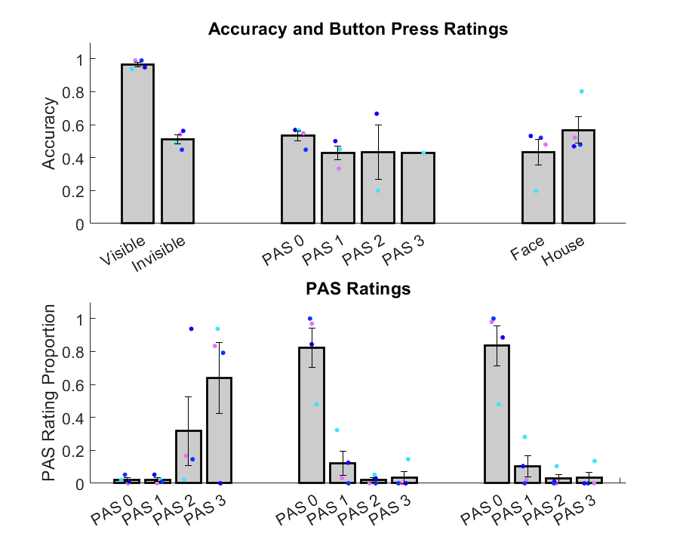
Button Press Ratings
Invisible
Blank
Visible
Invisible
Blank

Slide 7
